Slide 1
CAB BOOKING APPLICATION
By -Kartik Raut
Email id- kartikraut12112000@gmail.com
Submitted to – Wipro Technology

Slide 2
INDEX
Chapter | Contents | Slide number
1 | Project name and details of student | 1
2 | Index | 2
3 | Introduction | 3
4 | Design Diagram | 4
5 | User Story | 5
6 | Class Diagram | 6
7 8 | Tools Used and Modules Conclusion | 7,8 9

Slide 3
INTRODUCTION
In today’s revolutionizing world time and comfort is very valuable for everyone. Customers want quick access for cabs quick at their feet so cab booking system is very useful in our lives.
* PURPOSE- Offering a convenient and efficient solution for booking transportation services.
* SIGNIFICANCE -Addressing the need for reliable and accessible transportation in urban and suburban areas.
* VISUAL- Dynamic graphic illustrating the process of booking a cab via online.

Slide 4
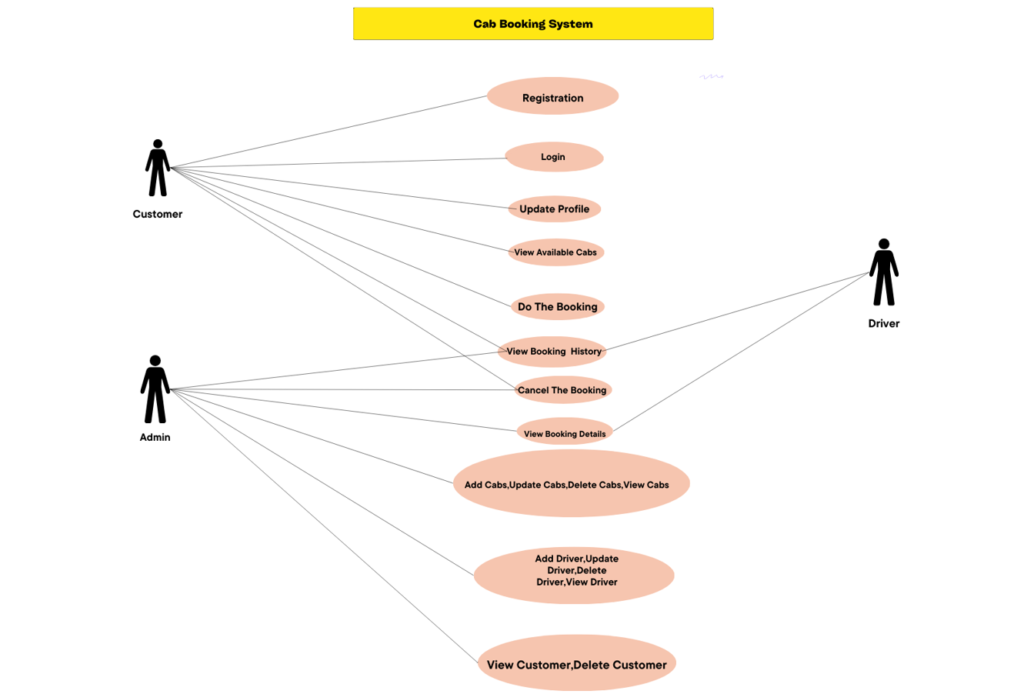
DESIGN DIAGRAM

Slide 5
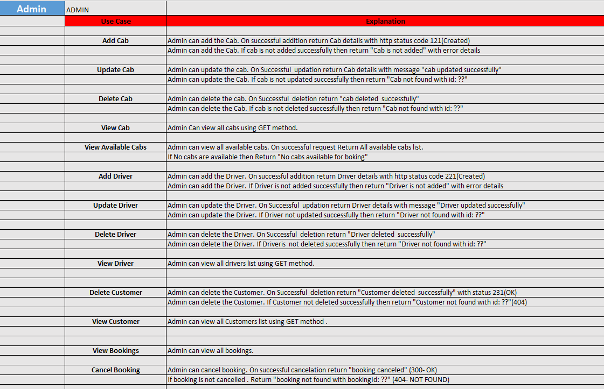
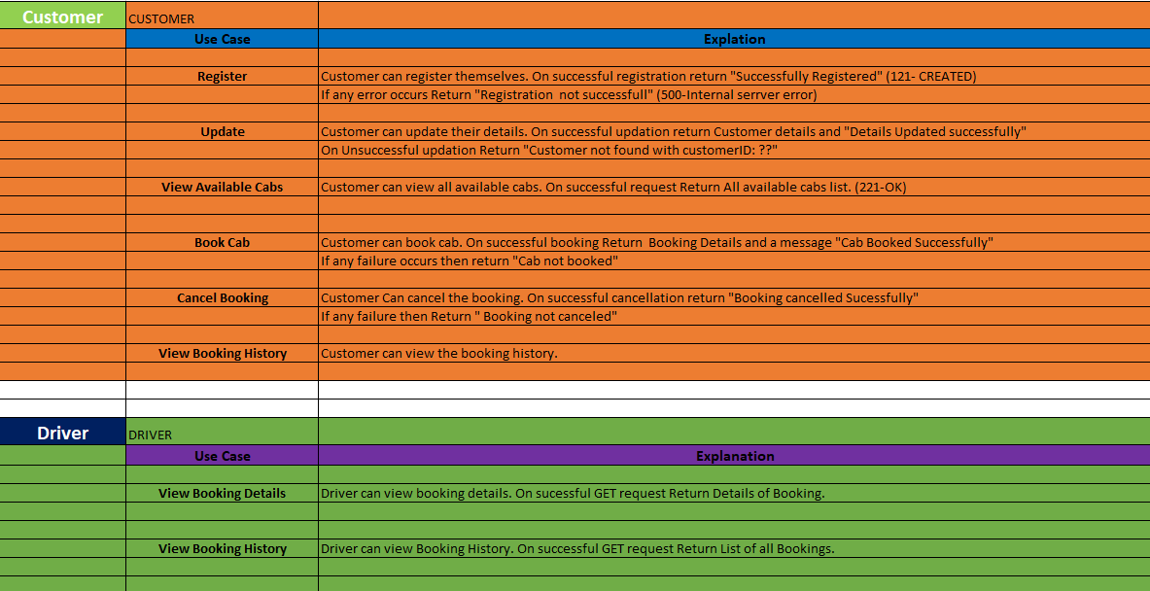
USER STORY

Slide 6
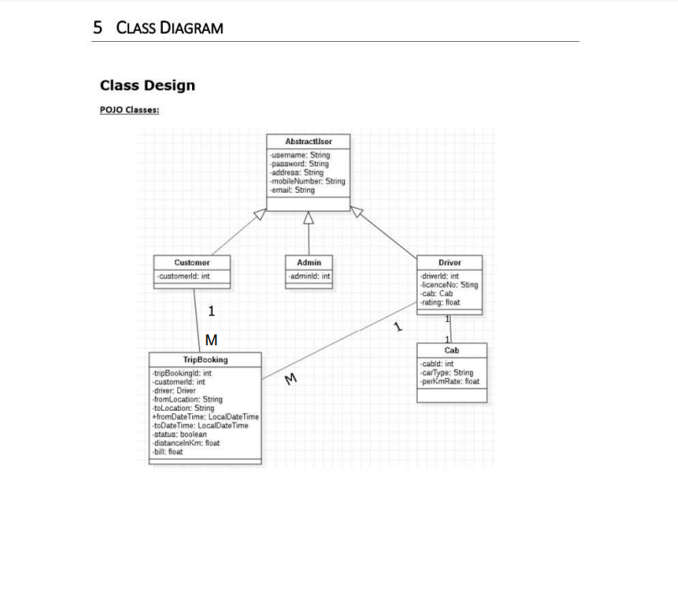
CLASS DIAGRAM

Slide 7
TOOLS USED
:-Spring boot
:-Rest Controller
:-Spring Data Jpa

Slide 8
MODULES
USER
MODULE
DRIVER
MANAGEMENT
MODULE
BOOKING
MANAGEMENT
MODULE
CAB
MANAGEMENT MODULE

Slide 9
ADVANTAGES
Highlighting the benefits and advantages of using the Cab Booking System:
Convenience: Instant access to transportation services anytime, anywhere.
Transparency: Clear pricing, route information, and driver details provided upfront.
Safety: Enhanced security features and accountability mechanisms for both passengers and drivers.

Slide 10
CONCLUSION
:-Empowering users with accessible and reliable transportation options.
:-Driving efficiency and convenience in urban mobility.
Paving the way for a safer and more connected transportation network.
:-Easy access to transportation facility for both urban and rural people.
:-Thus, reaching on the conclusion that cab booking sytem has huge role in making our life easier and smoother.;;

